Slide 1
Big Data Analytics Project
Elyas Alhabub 202036960
Ziyad Alshamrani 202021840

Slide 2
Table of Contents
Part 1: Data Understanding and Exploration | This part will mainly focus on understanding the datasets available to use.
Part 2: Data Preprocessing | Handling Missing Data, Feature Selection & Scaling, Encoding Categorical Variables
Part 3: Modeling | Algorithm Selection, Data Splitting, Model Training and Evaluation, Performance Analysis, Final Model Selection
Part 4: Visualization | Data Distribution, Feature Importance, Model Performance Across Features
Ending

Slide 3
01
Data Understanding and Exploration

Slide 4
Data Understanding and Exploration
Dataset Overview: The dataset contains a reorganized version of data sourced from the London Data Store,
showcasing energy consumption measurements for 5,567 London. The data specifically relates to electricity consumption recorded by smart meters.
Data collection duration: from November 2011 to February
2014.

Slide 5
Data Understanding and Exploration
The data contains multiple datasets:
informations_households.csv:
halfhourly_dataset.zip
daily_dataset.zip
acorn_details.csv
weather_daily_darksky.csv
weather_hourly_darksky.csv

Slide 6
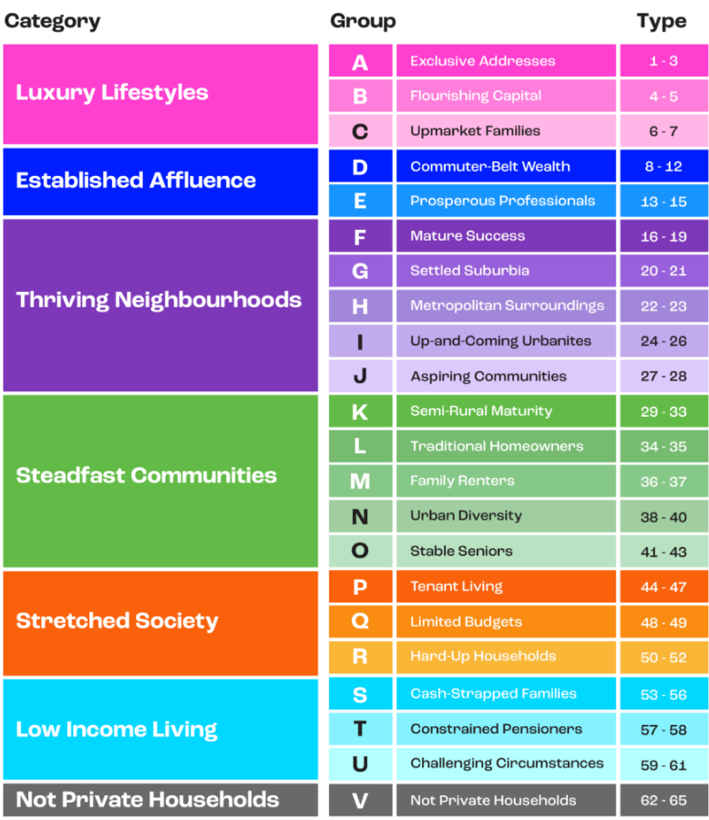
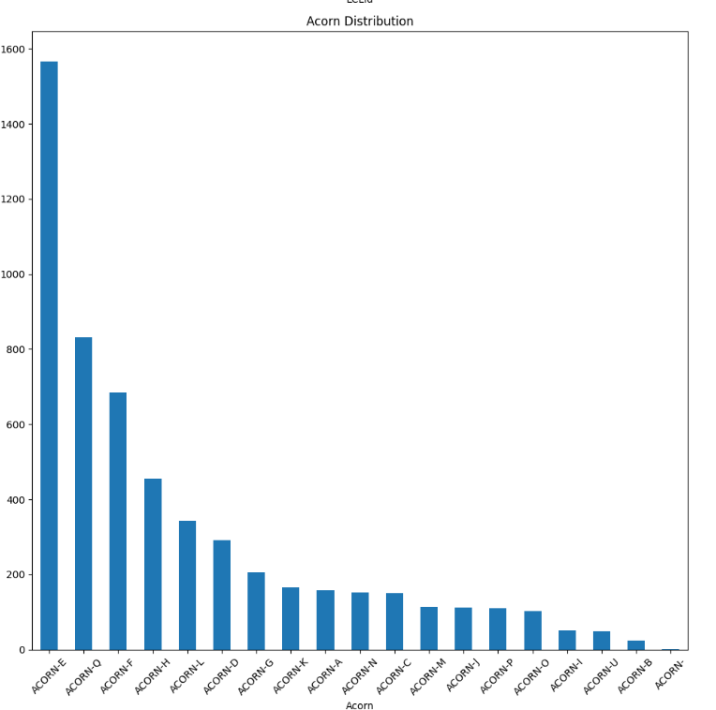
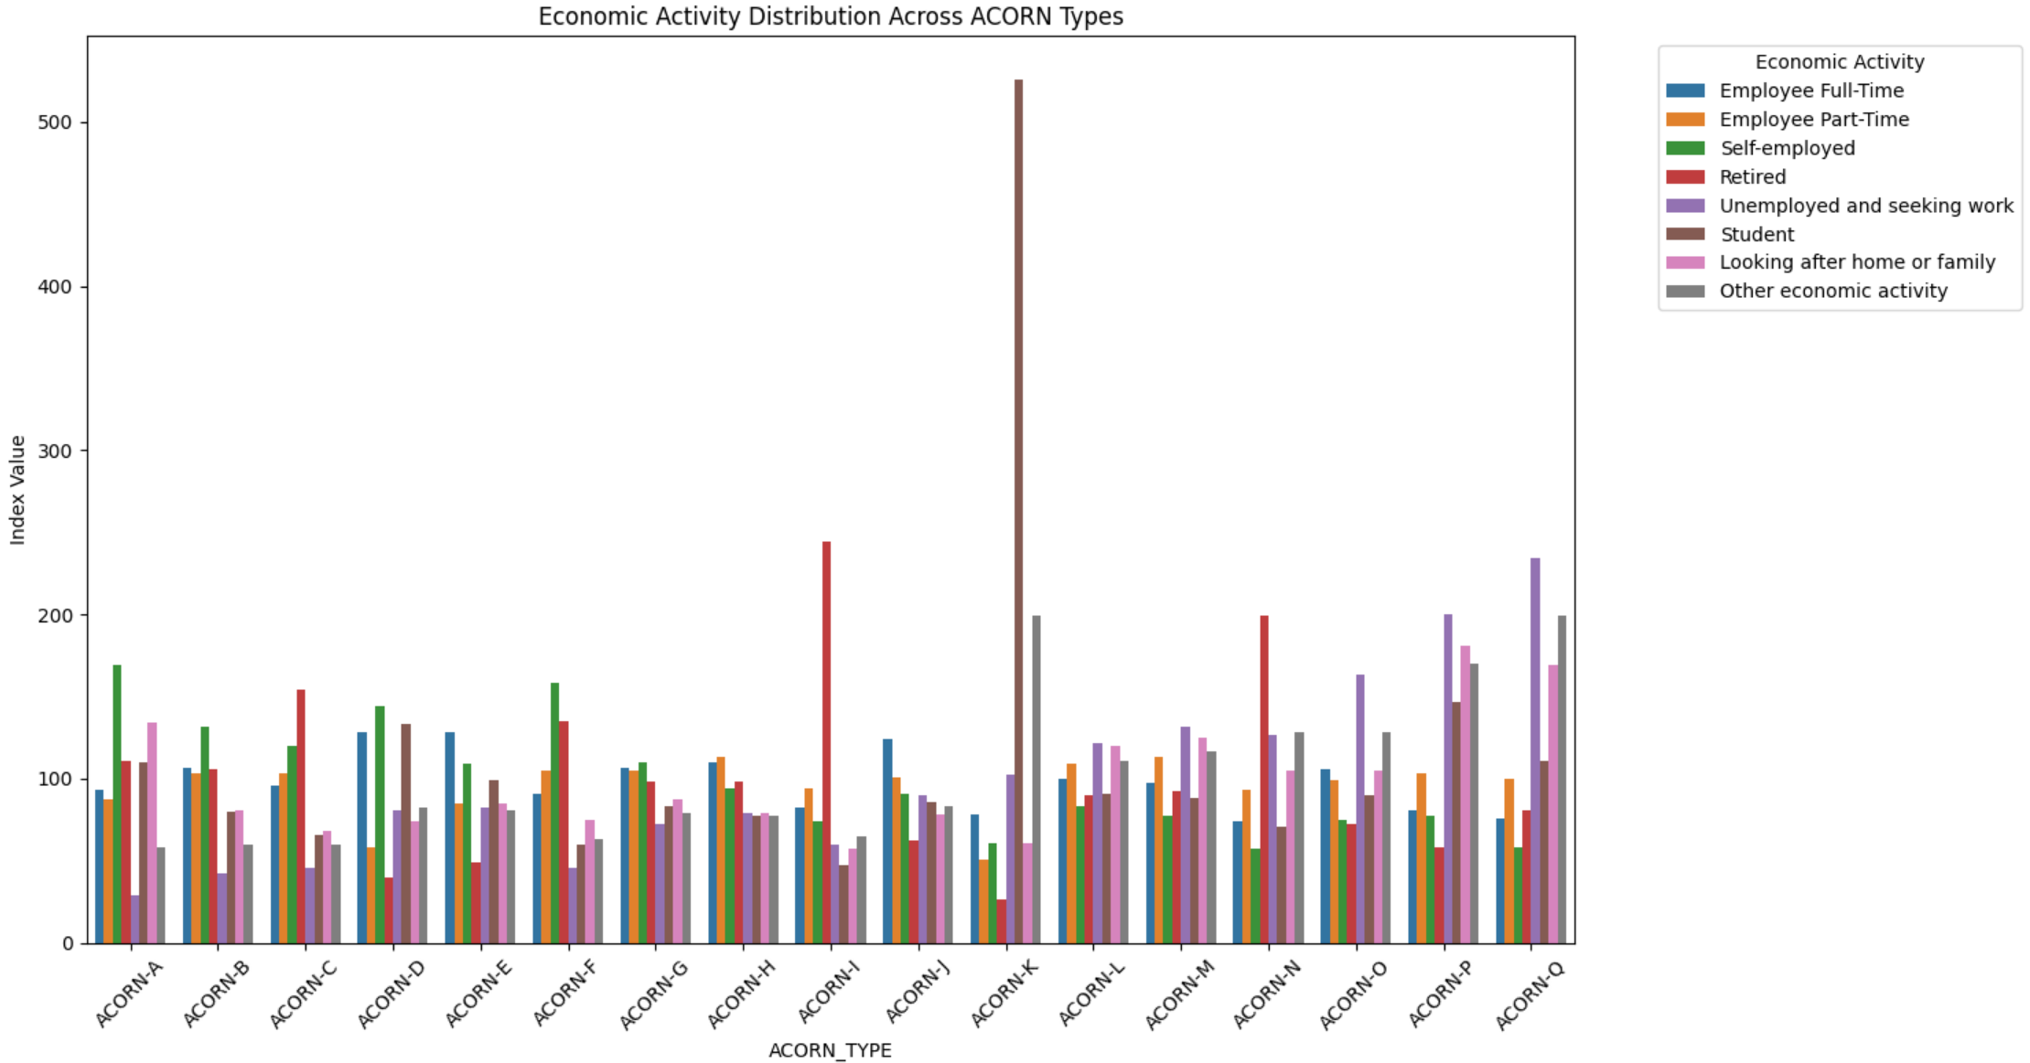
Data Understanding and Exploration
informations_households.csv:
contains detailed information about the households in
the panel, such as their ACORN group and tariff type. It also specifies which block.csv. file it belongs to.
Rows: 5,567 rows
Columns: 5 columns

Slide 7
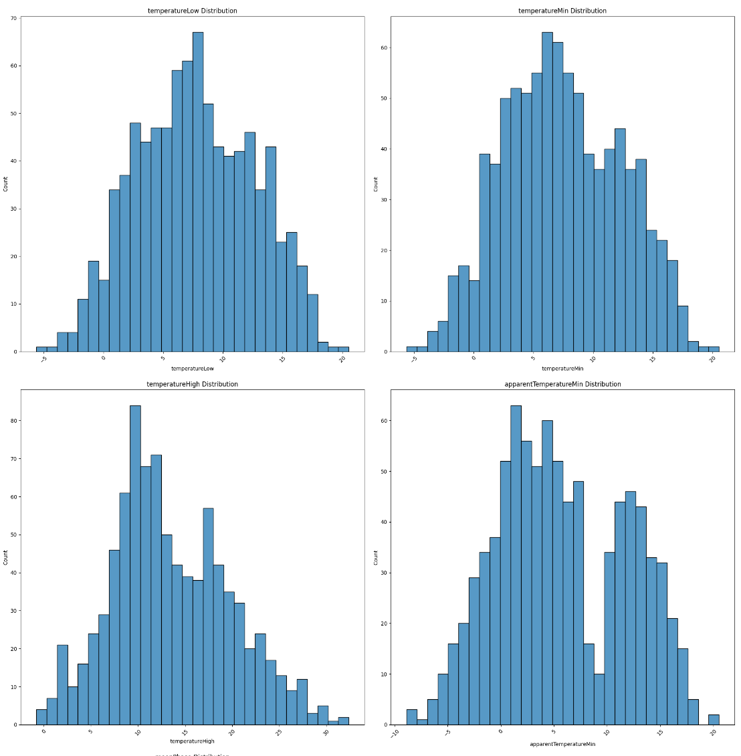
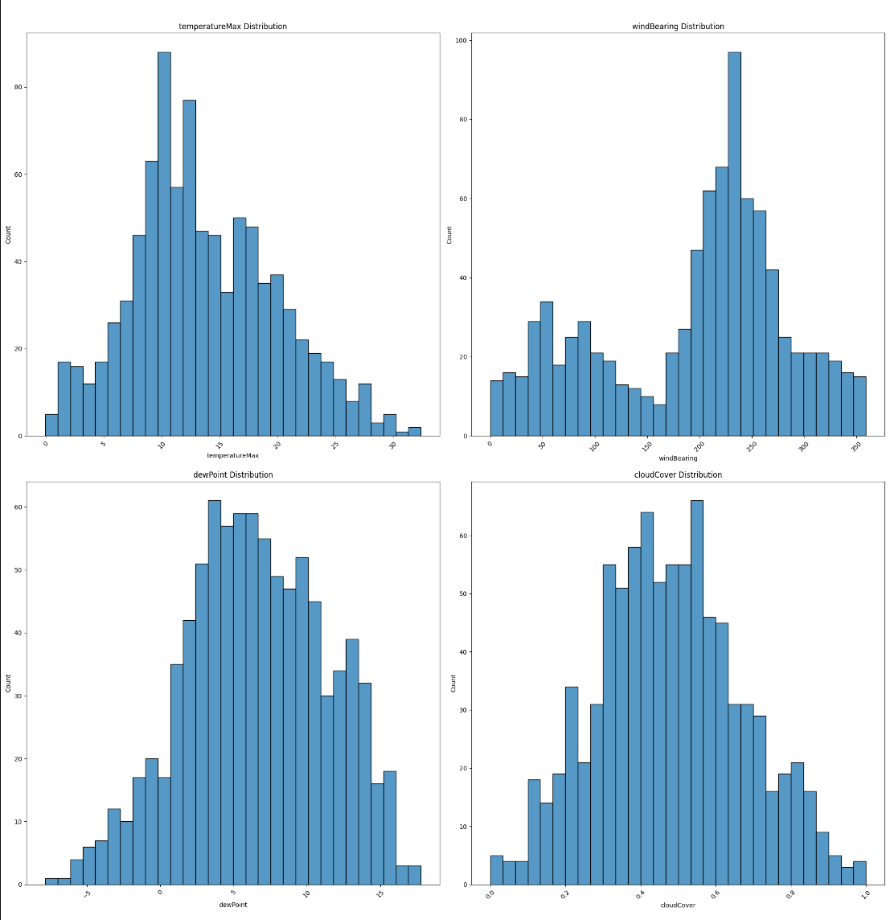
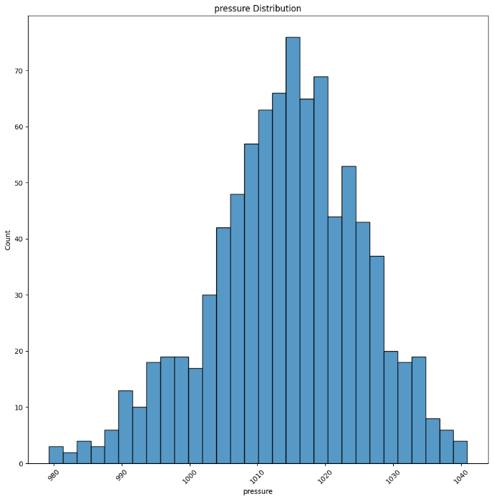
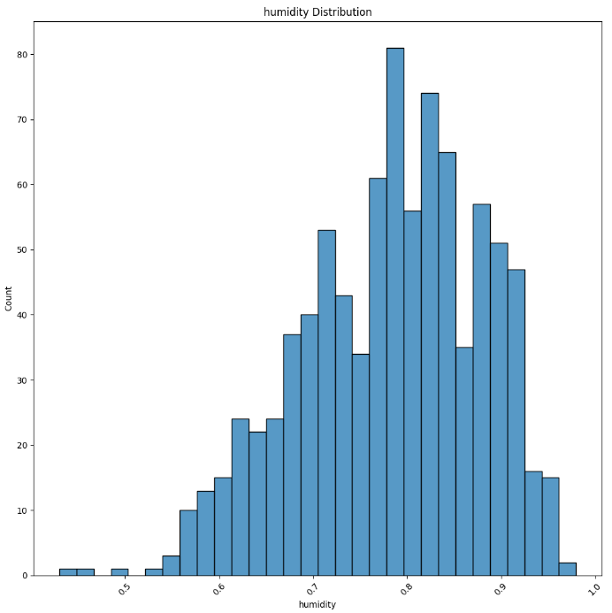
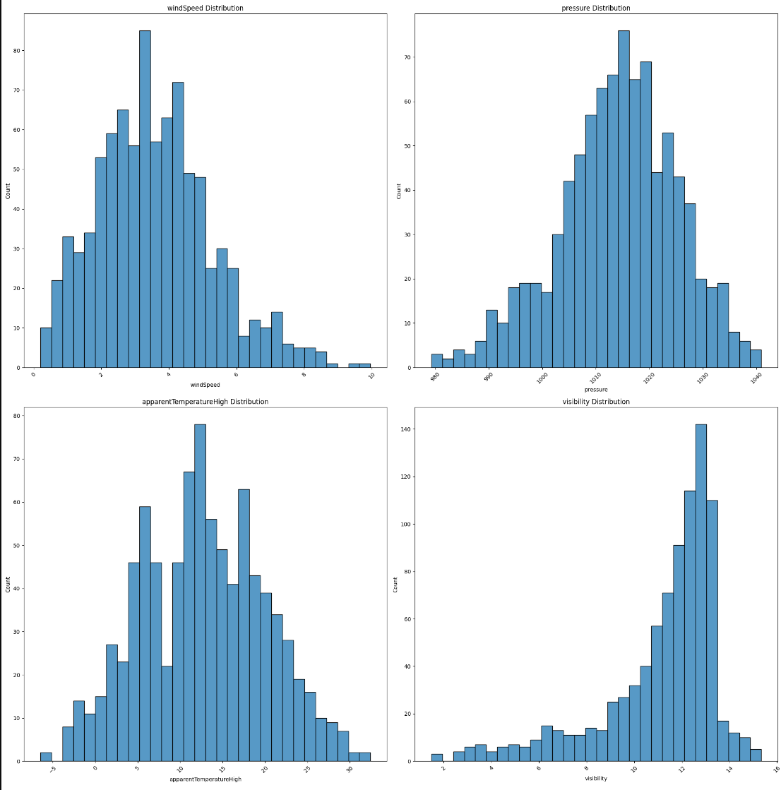
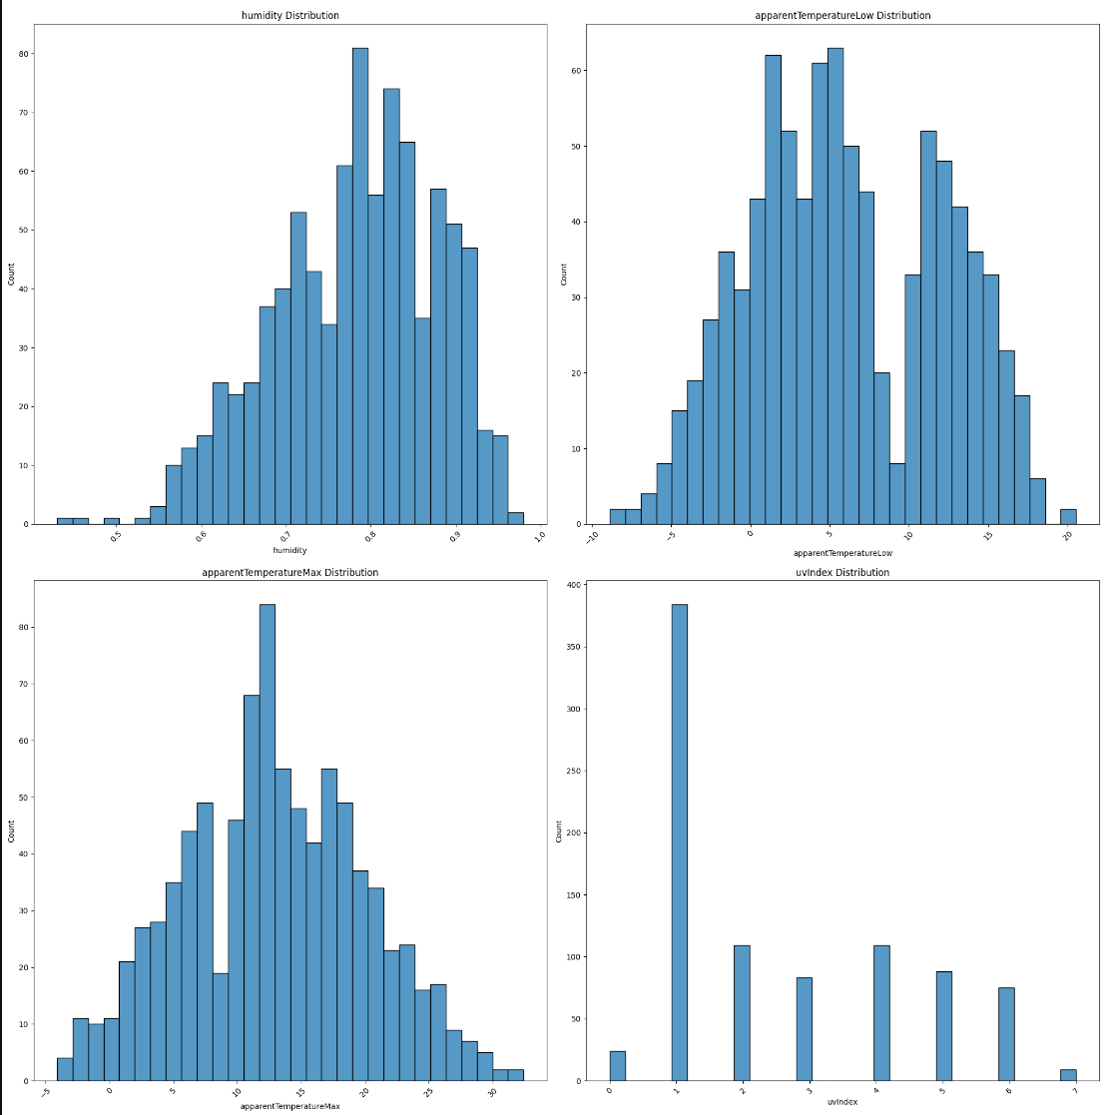
Data Understanding and Exploration
weather_daily_darksky.csv:
Contains daily weather data obtained from the Dark Sky API.
Additional information on the parameters is available in the API documentation.

Slide 8
Data Understanding and Exploration
Merging data:
The target variable of this project is the total energy consumption in London daily.
We combined all block data in daily_dataset (that has daily consumption for each house )
We found the total energy consumption daily by summing all consumptions in a single day
We cannot consider the acorn detail now since it was related to each house and block. Therefore, we will consider weather_daily_darksky dataset and uk_bank_holidays to see their effect on daily energy consumption in London.
We combined all datasets together in one dataframe called “merged_dataset” based on data

Slide 9
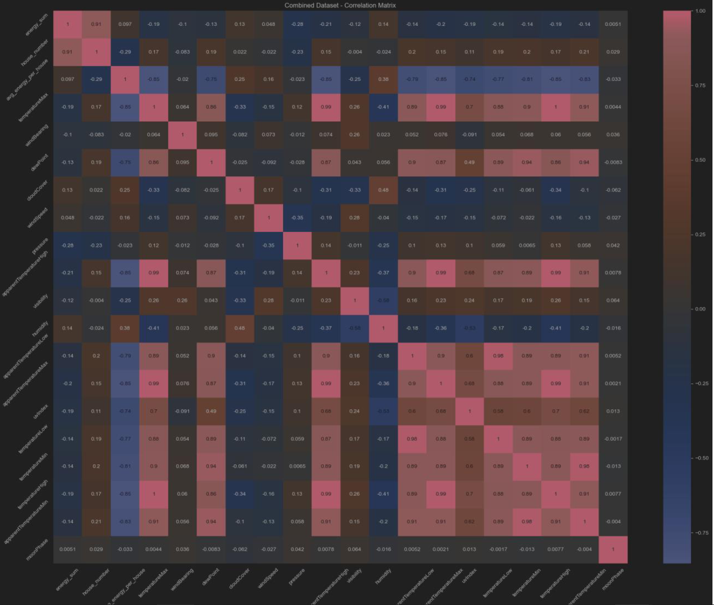
Data Understanding and Exploration
We found out that the number of houses is the highest correlated feature to the target variable with value of 0.91, then pressure with 0.28.

Slide 10
02
Data Preprocessing

Slide 11
Data Preprocessing
Handling Missing Data:
The columns that has missing data in merged dataset are:
• Column: cloudCover, Type: float64, Missing Values: 1
• Column: uvIndex, Type: float64, Missing Values: 1
• Column: uvIndexTime, Type: object, Missing Values: 1
• Column: holiday, Type: object, Missing Values: 811
Solution:
For numerical columns: we will replace the missing values with the mean value
For categorical columns: we will replace the missing values with the mode

Slide 12
Data Preprocessing
Feature Selection:
We did not considered all the columns that has time and date (except the day column), and the
columns that has summery of the data or meaningless information for our prediction
target, which is predicting the energy consumption in London for a given day.
Excluded columns | Remaining columns
house_number, avg_energy_per_house, temperatureMaxTime, temperatureMinTime, apparentTemperatureMinTime, apparentTemperatureHighTime, time, sunsetTime, sunriseTime, temperatureHighTime, uvIndexTime, temperatureLowTime, apparentTemperatureMaxTime, apparentTemperatureLowTime, icon, summary, precipType | day, energy_sum, windBearing, dewPoint, cloudCover, windSpeed, pressure, apparentTemperatureHigh, visibility, humidity, apparentTemperatureLow, apparentTemperatureMax, uvIndex, temperatureLow, temperatureMin, temperatureHigh, moonPhase, holiday

Slide 13
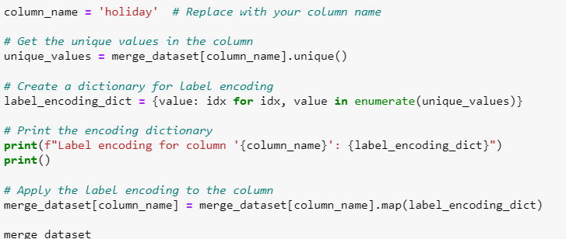


Data Preprocessing
Encoding Categorical Variables:
only “holiday” and “day” needs encoding.
For “holiday”, we used label encoding since it has many categories.
For “day”, we set the first data to zero and took it as a reference for any other date we have to convert the dates into numerical labels. So, if “11-11-2011” is day zero, then next day is day 1 and so on.

Slide 14
03
Modeling

Slide 15
Modeling
Algorithm Selection:
The target variable in our data is numerical, which is energy_sum. Therefore, the best
algorithm type to use in our case is regression algorithms to estimate the values in the
future. The regression algorithms that will be evaluated here are:
-Linear Regressor
- Ridge
- Decision Tree
- Random Forest
- ARD

Slide 16
Modeling
Model Training and Evaluation:
We will train and test each model 10 time, one for each fold then will find the average
results. Since we are evaluating regression, the best metrics to evaluate the mode are the
following:
R² (R-squared): R² is the proportion of variance in the dependent variable that is explained by the independent variables in the model.
RMSE (Root Mean Squared Error):RMSE is a measure of the average magnitude of errors between the predicted and actual values
R²: Higher is better
RMSE: Lower is better

Slide 17
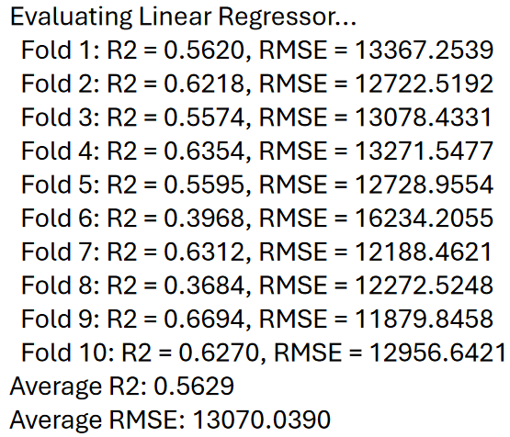
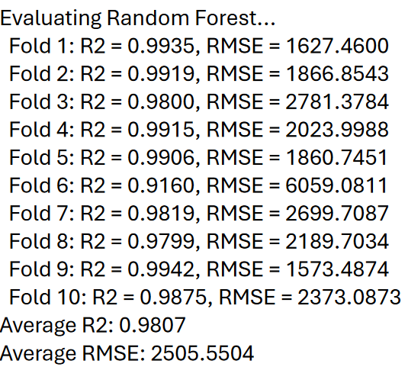
Modeling
Performance Analysis:The best regressor we found was “Random Forest Regressor”.

Slide 18
04
Visualization

Slide 19
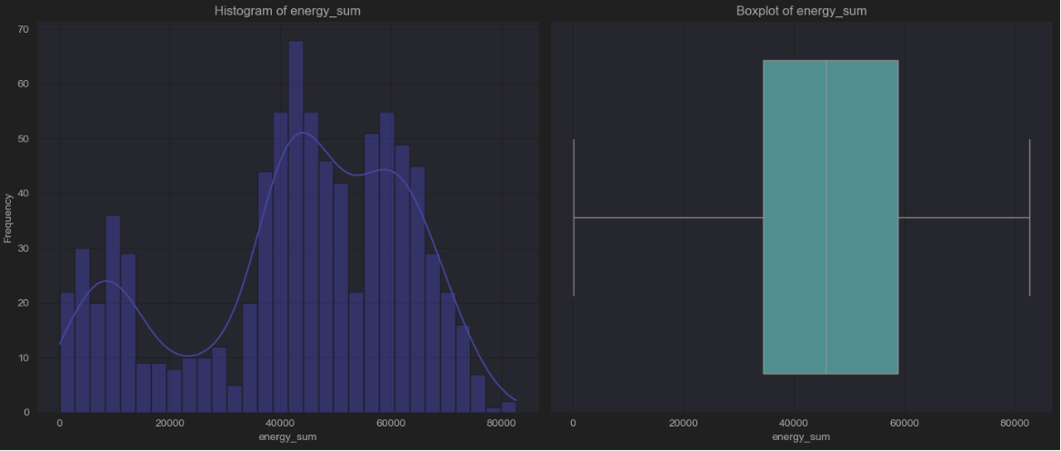
Visualization
Data Distribution: We are going to visualize the data before scaling or encoding.

Slide 20
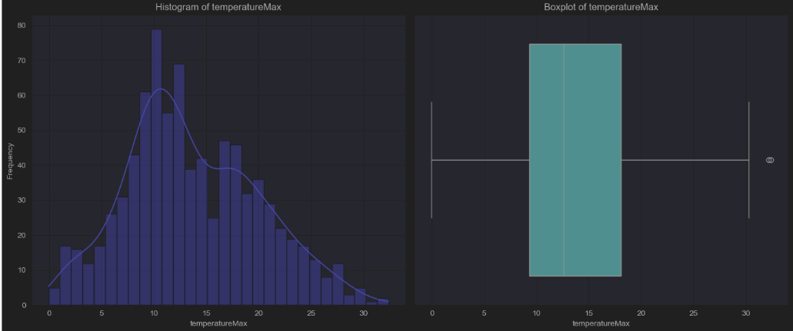
Visualization

Slide 21
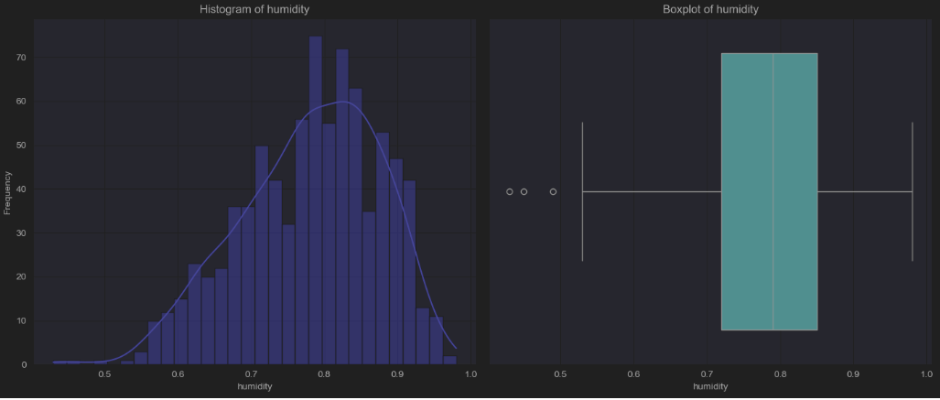
Visualization

Slide 22
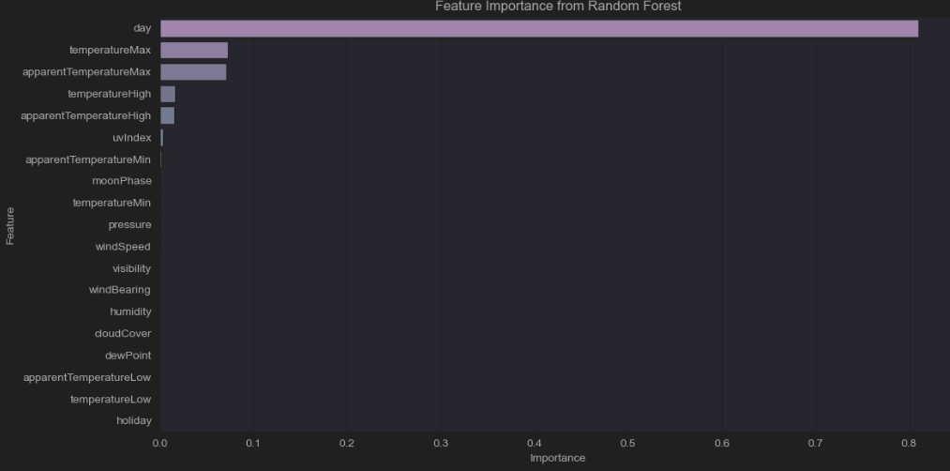
Visualization
Feature Importance:
Feature importance refers to how valuable each feature is in predicting the target variable.
Tree-based models (like the Random Forest Regressor) can easily provide feature
importance by evaluating the reduction in impurity (entropy) or variance due to each
feature during training.

Slide 23
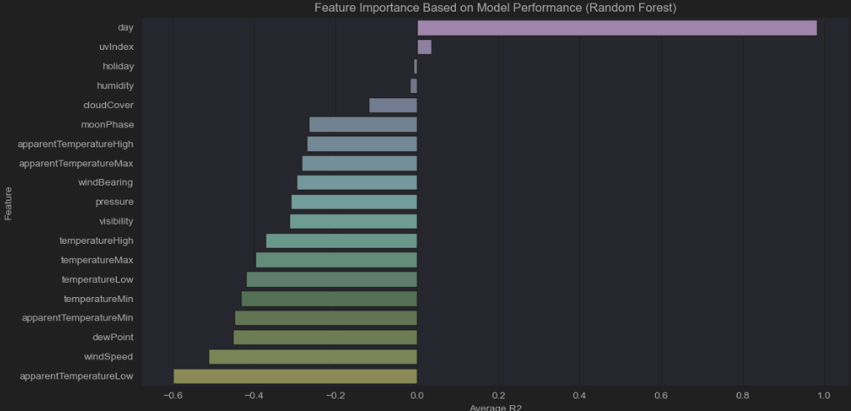
Visualization
Model Performance Across Features: this section evaluates the contribution of each feature individually to the overall performance of the model.

Slide 24
Thanks!
Questions?

